Slide 1
Introduction to Special Data Types
Definition and Importance:
Special data types refer to non-traditional data formats that require specialized methods for processing. These include audio files (e.g., .wav, .mp3), video files (e.g., .mp4, .avi), and images (e.g., .jpg, .png).
Understanding how to handle these data types is crucial in fields like machine learning, computer vision, and multimedia analytics.

Slide 2
Applications:
Audio analysis in speech recognition and music classification.
Video processing in surveillance and autonomous vehicles.
Image analysis in facial recognition and medical imaging.
Audio Data Handling:
to be cont.

Slide 3
Audio Data Handling
Audio signals are represented as time series data where amplitude is plotted against time, with formats include WAV, MP3, and AAC.
labels, transcription text, sample rates, and other relevant information are needed.
to be cont.

Slide 4
For audio processing
Loading Audio Files: Use libraries like Librosa to load audio files into NumPy arrays.
Resampling: Adjust the sample rate of audio files to ensure consistency across the dataset.
Feature Extraction: Extract features such as Mel-frequency cepstral coefficients (MFCCs), spectrograms, or raw waveforms for further analysis.
Normalization: Normalize audio data to ensure uniformity in amplitude levels.
Splitting Data: Divide the dataset into training, validation, and test sets.

Slide 5
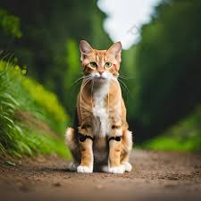

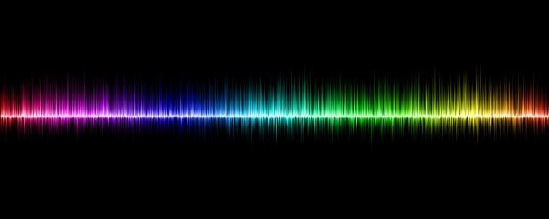

Images
f(x, y) = (R, G, B)
X * Y
R
G
B
X
B1, B2, ….. BN
A1, A2, ….., An
Y

Slide 6
Image Data Handling
Images are typically represented as pixel grids where each pixel has color values (RGB).
Common formats include JPEG, PNG, and TIFF.
Processing Techniques:
Image Enhancement: Techniques such as histogram equalization can improve image quality.
Feature Detection: Use algorithms like SIFT or ORB for identifying key points in images.

Slide 7
Pre processing involves Resizing and normalization.
Data Augmentation using tensorflow, improve model robustness .
Image trsnformation by rotation and flipping using transfom.Compose()
import cv2
# Read an image using OpenCV
image_path = 'path/to/image.jpg'
image = cv2.imread(image_path)
# Convert to grayscale
gray_image = cv2.cvtColor(image, cv2.COLOR_BGR2GRAY)
# Apply Gaussian blur
blurred_image = cv2.GaussianBlur(gray_image, (5, 5), 0)
# Display the processed image
cv2.imshow('Blurred Image', blurred_image)
cv2.waitKey(0)
cv2.destroyAllWindows()

Slide 8
Video Data Handling
Videos are sequences of images (frames) played in rapid succession.
Common formats include MP4, AVI, and MKV.
Processing Techniques:
Frame Extraction: Use OpenCV to read video files frame by frame.
Object Detection: Implement algorithms (e.g., YOLO or SSD) for detecting objects within video frames.

Slide 9
Video Pre processsing
Processing Video Data: Resizing Frames
To resize frames for consistent input dimensions in machine learning models.
# Resize frames using OpenCV
resized_frames = [cv2.resize(frame, (640, 480)) for frame in frames]
print(f'Resized frames shape: {resized_frames[0].shape}')
#Extracting Specific Frames
We can extract specific frames from the video for analysis or training purposes.
Concatenating Clips

Slide 10
